Slide 1



EDGE: BU-CSE DIGITAL SKILL TRAINING UNIVERSITY OF BARISHAL (BU)
Course name: computer fundamentals and office applications
Submitted by:
Name: Md Tariqul Islam Nayon
Department of Geology and Mining
University of Barishal
Submitted to:
Name: Md. Rashid Al Asif
Assistant Professor
Dept. of Computer Science & Engineering
University of Barishal

Slide 2
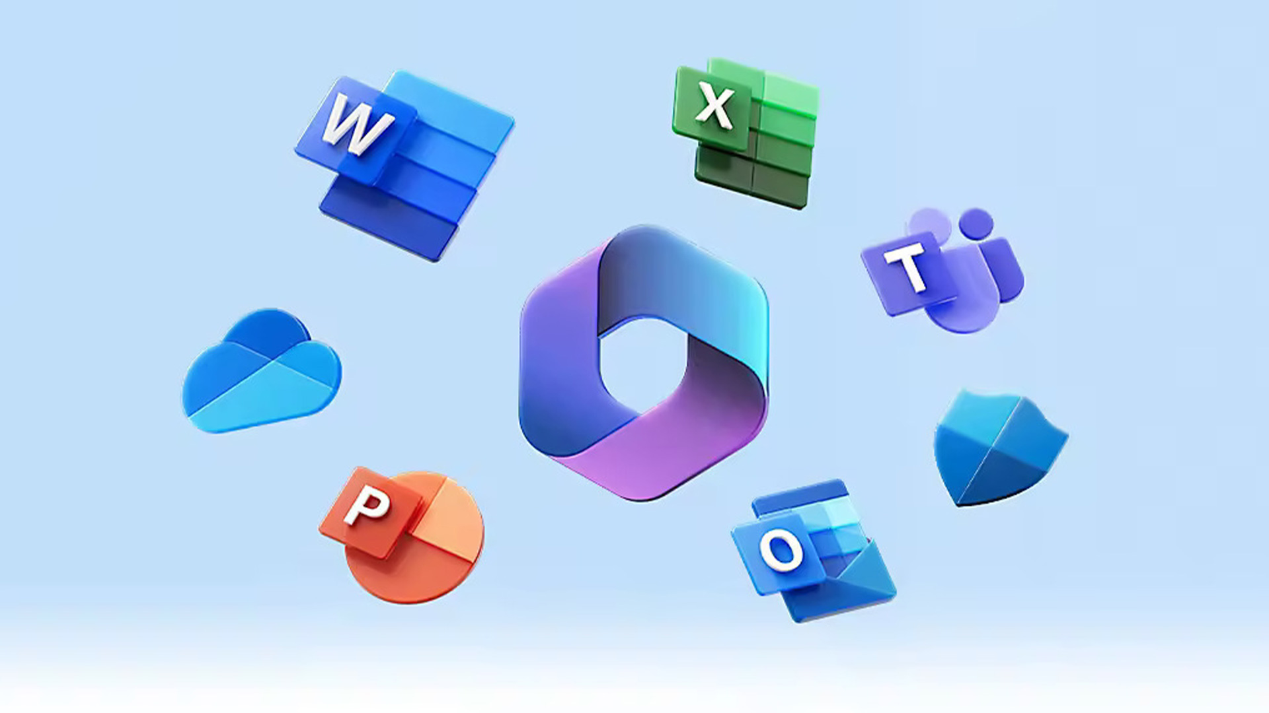

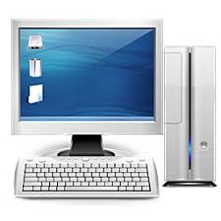
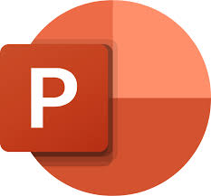
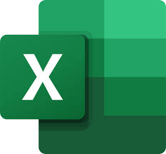

Course content:
Computer Basics
Microsoft Office Applications
Microsoft Word
Microsoft Excel
Microsoft PowerPoint

Slide 3
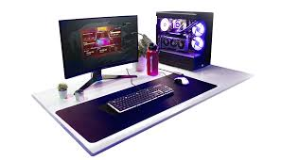
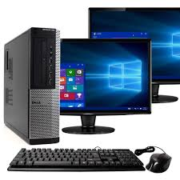
What is computer?
A computer is a programmable electronic device that accepts raw data as input and processes it with a set of instructions (a program) to produce the result as output. It can store, retrieve, and process data, and it can perform both numerical and non-numerical calculations. The term "computer" is derived from the Latin word "computare," which means to calculate.

Slide 4
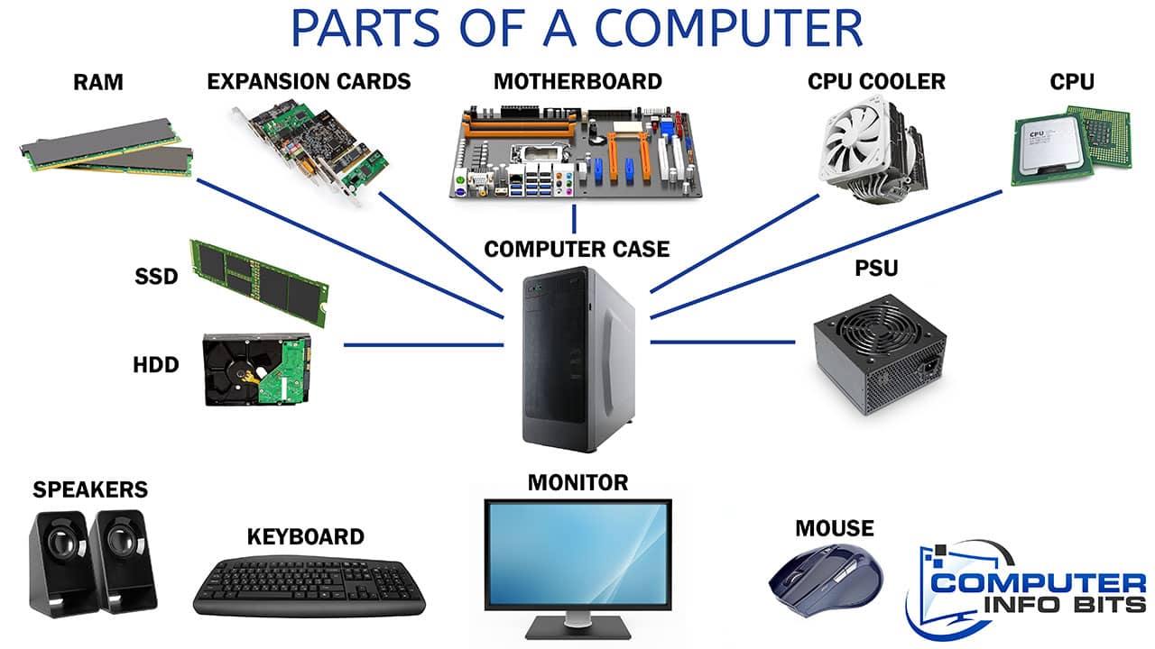
Parts of Computer:

Slide 5
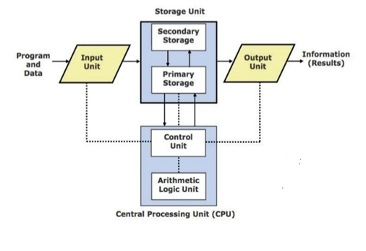
Computer Organization

Slide 6
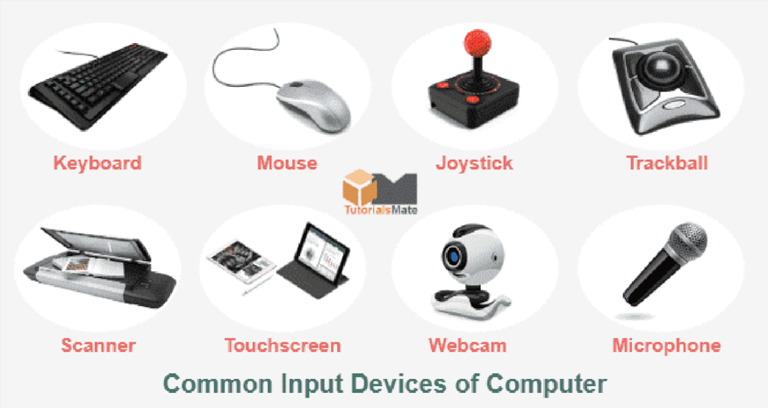
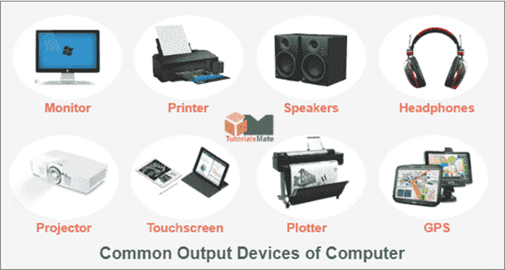
Computer components:
Input Devices:
Output Devices:

Slide 7
Few basic knowledge:
Creating New Folder
Deleting the Folder
Sort File in a Directory
File Properties
Copy-Paste a File
Cut-Move a File
Restore File from Recycle Bin
Search File & Folder
Adjust Date & Time

Slide 8
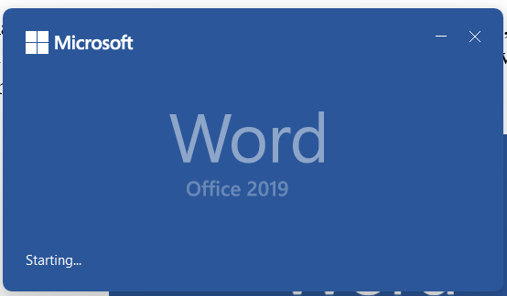
What is MS Word?
Used to make professional-quality documents, letters, reports, etc. MS Word is a word processor developed by Microsoft. It has advanced features which allow you to format and edit your files and documents in the best possible way.

Slide 9
Where to find MS Word on your personal computer?
Follow these simple steps to open MS Word on your personal computer:
Start → All Programs → MS Office → MS Word.
How to create an MS Word document?
To create an MS Word doc, follow the steps mentioned above to open Microsoft Word. Then once the program is open, click on “File” followed by “New”. This opens a new doc where something new can be created.

Slide 10
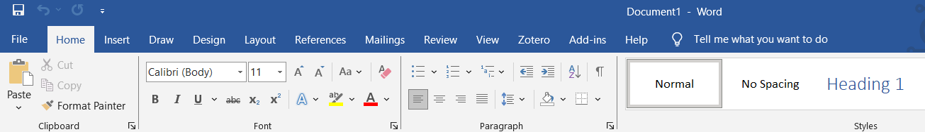
Features of MS Word
Now let us read more about the features and components of an MS Word doc file in detail.
The image given below shows the different elements and categories which are available in MS Word doc:
Home
This has options like font color, font size, font style, alignment, bullets, line spacing, etc. All the basic elements which one may need to edit their document is available under the Home option.:

Slide 11
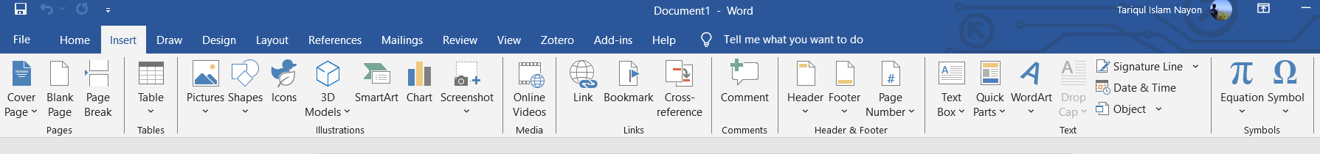
Insert
Tables, shapes, images, charts, graphs, header, footer, page number, etc. can all be entered in the document. They are included in the “Insert” category.

Slide 12
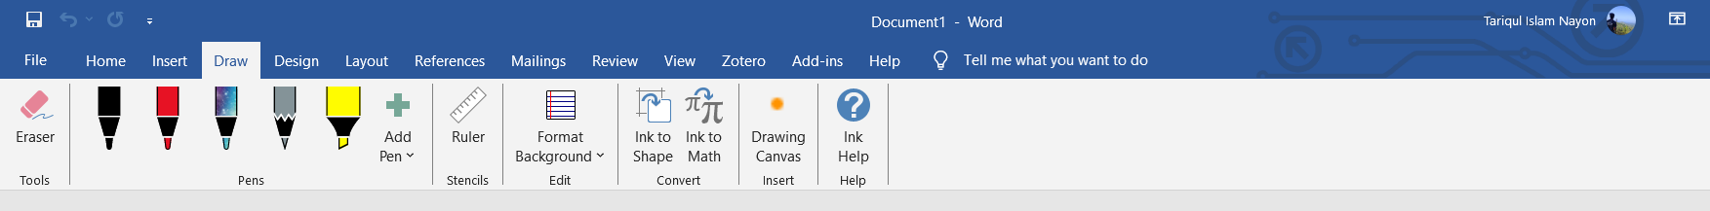
Draw
The Draw ribbon in Microsoft Word use to add freehand drawings and annotations to documents. It's useful for various purposes such as: sketches and diagram, handwritten annotation, emphasis and illustrations.

Slide 13
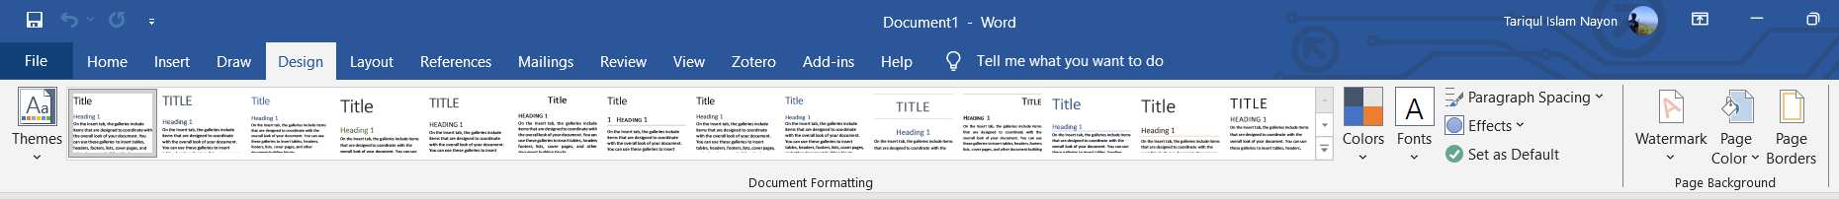
Design
The template or the design in which you want your document to be created can be selected under the Design tab. Choosing an appropriate tab will enhance the appearance of your document.

Slide 14
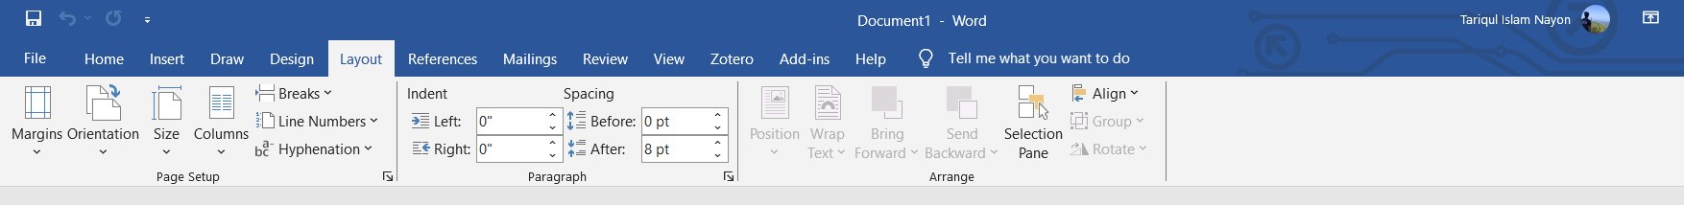
Page Layout
Under the Page Layout tab comes options like margins, orientation, columns, lines, indentation, spacing, etc.

Slide 15
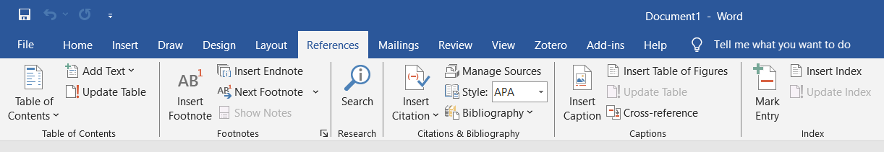
References
This tab is the most useful for those who are creating a thesis or writing books or lengthy documents. Options like citation, footnote, table of contents, caption, bibliography, etc. can be found under this tab.

Slide 16
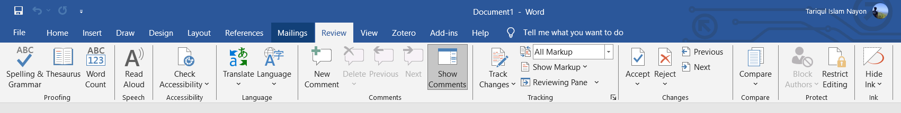
Review
Spell check, grammar, Thesaurus, word count, language, translation, comments, etc. can all be tracked under the review tab. This acts as an advantage for those who get their documents reviewed on MS Word.

Slide 17
What is Microsoft Excel?
Microsoft Excel is spreadsheet software designed and developed by Microsoft for various computing devices running on Windows, Linux, Android, and Mac Operating systems. MS Excel performs business intelligence and data analytics functions by generating visually appealing charts.

Slide 18
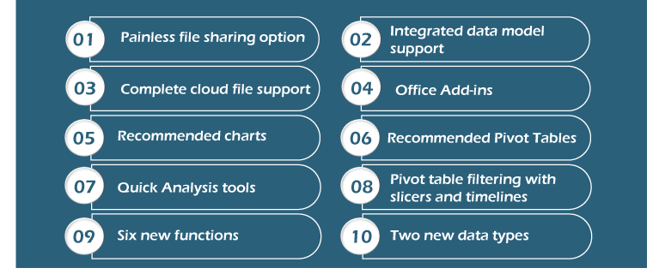
Top 10 Features of MS Excel

Slide 19
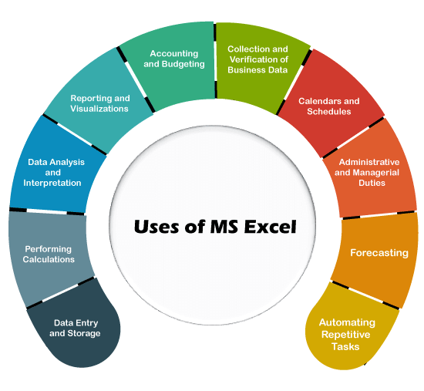

Slide 20
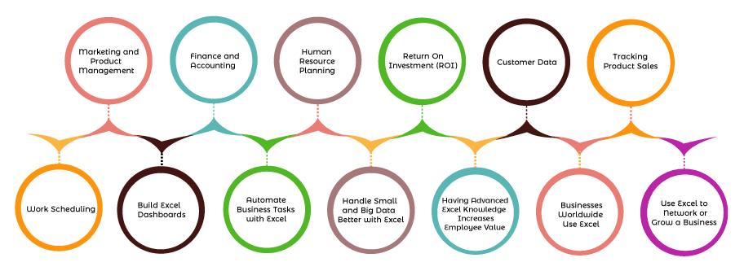
Why MS Excel is Important in Business

Slide 21
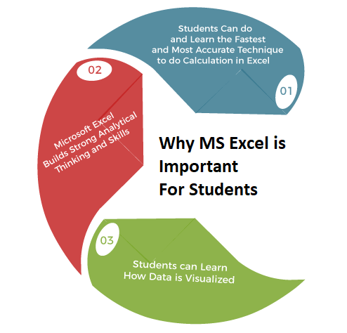
Why MS Excel is Important for Students

Slide 22
What is MS PowerPoint?
PowerPoint (PPT) is a powerful, easy-to-use presentation graphics software program that allows you to create professional-looking electronic slide shows.
MS PowerPoint is a program that is included in the Microsoft Office suite. It is used to make presentations for personal and professional purposes.
What is a PowerPoint presentation or PPT?
A combination of various slides depicting a graphical and visual interpretation of data, to present information in a more creative and interactive manner is called a PowerPoint presentation or PPT.

Slide 23
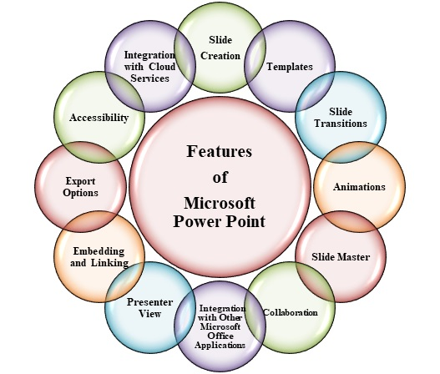

Slide 24
Thank You

